Slide 1
AI-Based Resume Screening and
Candidate Ranking System
Using DevSecOps and MLOps
ENGINEERING CAPSTONE PROJECT – 1
Animesh Balaji Patro • Navaneeth • G. Satya Austin Abner • Syed Musaib
Guide: Dr. Bhavya Varma Kalidindi
Department of CSE • A.Y. 2026–2027

Slide 2
Problem Statement
Organizations often receive hundreds of applications for a single job opening, and reviewing every resume by hand does not scale.
• Manual screening consumes significant recruiter time.
• Human error can lead to inconsistent evaluation between reviewers.
• Qualified candidates may be missed due to keyword-only matching.
• Recruiters need an objective, scalable, and secure way to rank candidates.
ASE Project • 2026–2027

Slide 3
Objectives
1
Automate resume screening by extracting and analyzing resume content.
2
Rank candidates based on relevance to the job description.
3
Reduce manual effort and overall recruitment time.
4
Demonstrate Agile, DevOps, DevSecOps, and MLOps practices end-to-end.
5
Deploy a secure, scalable, and monitored application.
ASE Project • 2026–2027

Slide 4
Existing System
Traditional and baseline recruitment workflow
Receive resumes
Manual review
Keyword matching
Shortlist
Human decision
Large volumes require significant recruiter time.
Keyword matching may miss synonyms and contextual relationships.
Evaluation can vary between recruiters.
Manual workflows provide limited traceability and repeatability.
Security, CI/CD, deployment, model versioning, and monitoring are often handled separately.
LIMITATIONS
Time-consuming
Inconsistent
Keyword-dependent
Hard to scale
Limited automation
ASE Project • 2026–2027

Slide 5
Proposed System
An AI-based Resume Screening & Candidate Ranking System
The system automates the initial stage of recruitment using natural language processing and machine learning, replacing manual keyword-based review.
• Extracts skills, education, certifications, and experience automatically from resumes.
• Computes an objective relevance score using TF-IDF similarity against the job description.
• Produces a ranked candidate list with matched skills and up to 2 key skill gaps.
• Secures the pipeline with DevSecOps practices: SonarQube, Trivy, and OWASP ZAP.
• Tracks experiments and monitors performance with MLOps tools: MLflow, Prometheus, and Grafana.
ASE Project • 2026–2027

Slide 6
Technology Used
Languages, tools, database, and frameworks
Layer
Technology
Language / ML
Python • NLP • TF-IDF • Machine Learning
Backend
Flask API
Input
PDF / DOCX resumes
Version Control
Git • GitHub
CI/CD
GitHub Actions
Deployment
Docker • Kubernetes • Minikube
Security
SonarQube • Trivy • OWASP ZAP
MLOps
DVC • MLflow
Monitoring
Prometheus • Grafana
ASE Project • 2026–2027

Slide 7
Workflow
How the system processes a resume, step by step
1
2
3
4
5
6
7
Resume Upload
→
Text Extraction
→
Preprocessing
→
TF-IDF Vectorization
→
Similarity Scoring
→
Candidate Ranking
→
Recruiter Dashboard
Resumes are accepted in PDF/DOCX format; the trained model is exposed through a Flask API and integrated with a recruiter web interface. Development follows Scrum with automated testing and CI/CD via GitHub Actions.
ASE Project • 2026–2027

Slide 8
Modules
Main modules and features of the system
Resume Processing Engine
Recruiter Dashboard
DevSecOps Pipeline
Parses resumes, extracts skills/education/experience, computes TF-IDF similarity and ranking.
Displays ranked candidates with matched skills and up to 2 key skill gaps.
Git/GitHub, Docker, GitHub Actions, Kubernetes, SonarQube, Trivy, OWASP ZAP.
MLOps Pipeline
Monitoring
DVC dataset versioning, MLflow experiment tracking and model registry.
Prometheus and Grafana for application health and performance metrics.
ASE Project • 2026–2027

Slide 9
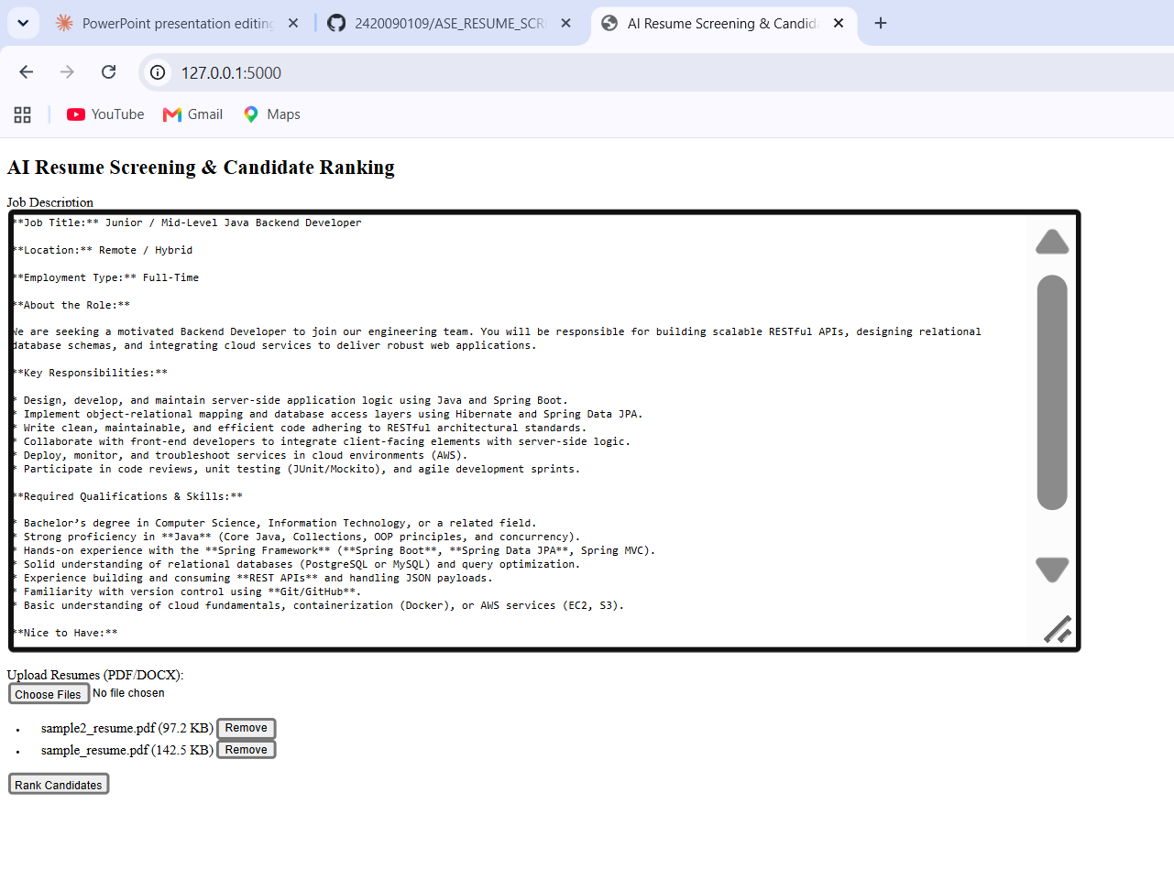
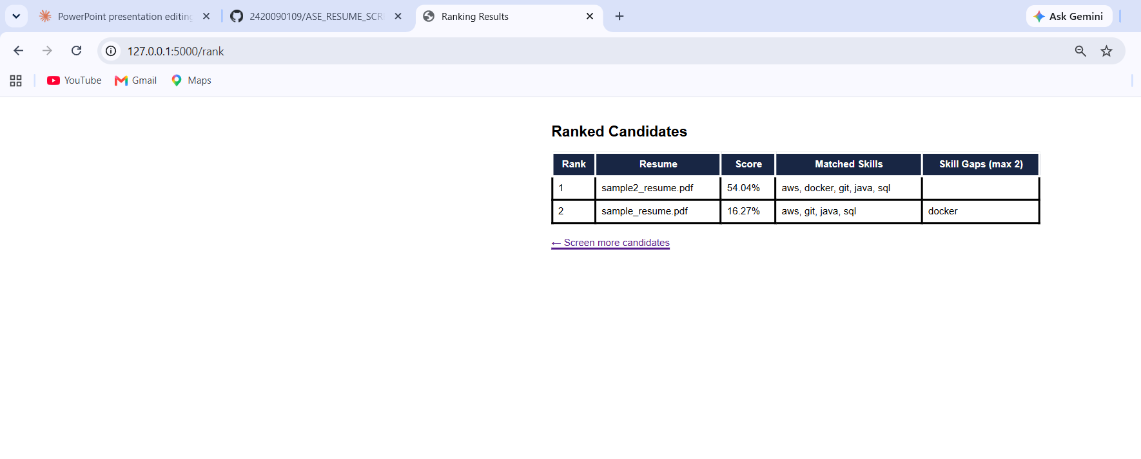
Implementation
Work completed so far — update with your actual progress
COMPLETED SO FAR
SCREENSHOTS
[Requirements gathered, backlog created, Git/GitHub repo set up ]
[Resume/JD upload UI built ]
[Text extraction module working ]
[ NLP preprocessing + TF-IDF engine in progress ]
[ Insert screenshot: e.g. Candidate Ranking Output ]
GitHub Repository: https://github.com/2420090109/ASE_RESUME_SCREENING_SYSTEM
ASE Project • 2026–2027

Slide 10
Conclusion & Future Scope
CURRENT STATUS
FUTURE SCOPE
Core resume parsing, NLP preprocessing, and TF-IDF-based candidate ranking are functional, with DevSecOps and MLOps integration progressing through iterative Agile Scrum sprints.
• Web interface for resume and job-description uploads
• Automated candidate ranking based on relevance
• Matched skills and up to 2 key skill gaps per candidate
• Reduced screening time and improved consistency
• Extend ranking with GitHub-based project evidence — verifying claimed skills using public repositories, languages, and project descriptions.
• Explore semantic/BERT-based matching beyond TF-IDF for deeper context understanding.
• Add fairness-aware ranking to help reduce bias in candidate scoring.
• Complete full Kubernetes deployment with end-to-end monitoring via Prometheus and Grafana.
ASE Project • 2026–2027

